Slide 1
Linked List

Slide 2
Pointers
A variable that stores the address of another variable.
Pointers are type specific, meaning a char type pointer can hold the address of a char variable and will throw an error if it is assigned the address of an int variable.
Syntax
int x=25;
int *ptr = &x;
//&x gives the address of the variable x, here ptr is an integer pointer

Slide 3
Special types of Pointers
Void Pointer
A pointer that has no explicit type. This is especially used when we dynamically allocate memory for a variable before hand (using malloc) and we are unsure about which type of variable the pointer should point to.
Syntax
Int p = 10;
void *ptr = &p;
printf(“%d”, (int *)ptr);
Null Pointer
A null pointer is a kind of pointer that does not point to any memory location. This is used to initialize a pointer variable.
Syntax
int *ptr=NULL;

Slide 4
Special Types of Pointer
Dangling Pointer
The pointers pointing to a deallocated memory block are known as Dangling Pointers. This condition generates an error known as Dangling Pointer Problem. Dangling Pointer occurs when a pointer pointing to a variable goes out of scope or when an object/variable's memory gets deallocated
Example
int a=10;
int *ptr=&a;
free(ptr);
The pointer still holds the address but the memory is freed, this kind of a pointer is a dangling pointer.
To avoid a dangling pointer, we have to reassign the pointer to Null after we free the memory.
Example
int a=10;
int *ptr=&a;
free(ptr);
Ptr=NULL

Slide 5
Wild Pointer
A pointer that is declared but not initialized is called a wild pointer.
They point to some arbitrary memory and may cause the program to crash later on
Example
int *arr;
for(int i=0;i<5;i++){
printf(“%d”, arr[i]);
}
Output- 89999 71666 0 2 766
//Random values
To avoid wild pointers initialize pointers to NULL while declaration
Ex-
int *arr= NULL;

Slide 6
Dereferencing a Pointer
Dereferencing a pointer means to to access or manipulate the data stored at the memory location, which is pointed by the pointer.
Any operation applied to the dereferenced pointer will directly affect the value of the variable that it points to.
Dereferencing operator= *
Ex
int a=10;
int *ptr = &a;
printf(“%d”, *ptr);
//Output=10
printf(“%d”, (*ptr) +10);
//Output=20
*ptr = 5;
printf(“%d”, a);
//Output=5

Slide 7
Static Memory Allocation
Static memory allocation is the process of allocating memory during compile time. There is no way of increasing or decreasing the size of memory allocated during compile time, it is fixed
Like a static array
arr[5]=[1,2,3,4,5]
In this case, if the user enters only 4 elements in the array, memory wastage takes place
If the user tries to enter more than 5 elements, there is an array index out of bounds error.

Slide 8
Dynamic Memory Allocation
The process of allocating Memory during run-time is called Dynamic Memory Allocation
The memory is allocated in Heap segment of the memory
The pre-defined Functions for dynamic memory allocation and deallocation are
Malloc
Calloc
Free

Slide 9
Malloc
The “malloc” or “memory allocation” method in C is used to dynamically allocate a single large block of memory with the specified size
It returns a void pointer pointing to the first location of the memory, the void pointer has to be typecasted to desired type
It does not initialize memory at allocation, hence memory allocated has garbage value at the time of creation
Returns a null pointer if memory is not available
Syntax-To create an integer array of size 5
int *arr = (int *)malloc(5*sizeof(int))

Slide 10
Calloc
calloc” or “contiguous allocation” method in C is used to dynamically allocate the specified number of blocks of memory of the specified type
It initializes each block with a default value ‘0’.
It has two parameters or arguments as compared to malloc().
Syntax to create an integer array of 5 elements
Int *arr = (int *)calloc(5, sizeof(int))

Slide 11
Free
“free” method in C is used to dynamically de-allocate the memory. The memory allocated using functions malloc() and calloc() is not de-allocated on their own
It helps to reduce wastage of memory by freeing it.
Syntax
Int *arr=(int *)malloc(5*sizeof(int));
//Operate on arr
free(arr);

Slide 12
Struct in C
Structure is used to create user defined data type in C.
Similar to Classes in Java
A structure creates a data type that can be used to group items of possibly different types into a single type.
Ex
struct employee{
int id;
float salary;
char name[20];
}
Struct employee e1;
e1.name=“Poulami”;
e1.id=873288;
e1.salary=500.50;
Struct employee *empPtr;
empPtr->name=“John”;
empPtr->id=987654;
empPtr->salary=1000.50;

Slide 13
Self Referential Structure
A structure that has atleast one pointer that points to a structure of its own kind.
Ex-
struct node{
int value;
int data;
struct node *next;
struct node *prev;
}

Slide 14
Linked List
It is a linear data structure consisting of connected nodes where each node has corresponding data and a pointer to the address of the next node.
They are not stored in contiguous locations in memory unlike arrays
The first node is called the HEAD/Start node
The last node points to NULL
In a singly linked list, traversal is always unidirectional

Slide 15
Linked List Representation
Val 1 10
Val 2 20
Val 3 30
Val 4 40
Val 5 Null
START NODE

Slide 16
Code to Create the struct for Singly Linked List and start node
struct node {
int data;
struct node *next;
}
Struct node *start = NULL;

Slide 17
Creating a Linked List (Logic 1)
If there is no node present in the linked list(empty list), then start should point to null.
We have to create a new node and make that the start node.
If Start = NULL, make start = newnode
NEWNODE
Val NULL
START
NULL

Slide 18
Creating a Linked List (Logic 2)
If there is an existing list, newnode should be assigned at the end.
Traverse to the end of the list and add the newnode to it
Ptr will traverse the list till ptr points to null(reaches the end node)
Val 1 10
Val 2 20
Val 3 30
Val 4 40
Val 5 Null
50
START
PTR
PTR
PTR
PTR
PTR
Val NULL
NEWNODE

Slide 19
Code to Create a LinkedList
struct node *createLinkedList(struct node *start){
struct node *newnode,*ptr;
int value=0;
printf(“Enter value of node, Press -1 to exit”);
scanf(“%d”, &value);
while(value!=-1){
newnode=(struct node*)(malloc(sizeof(struct node));
newnode->data = value;
if(start == NULL){
start = newnode;
newnode->next=NULL;
}
else{
ptr = start;
while(ptr->next!=NULL)
{
ptr=ptr->next;
}
ptr->next=newnode;
newnode->next = NULL;
}
printf(“Enter new node value”);
scanf(“%d”, &value);
}
return start;

Slide 20
Inserting a Newnode in a linked list
Insert at the Beginning
Insert at the End-Same as Creating a List(Logic 2)
Insert Before a particular Node
Insert After a particular Node

Slide 21
Insert at the Beginning
Make the newnode point to start and update the head/start to point to the newnode
Val 1 10
Val 2 20
Val 3 30
Val 4 40
Val 5 Null
START
Val NULL
05
Start
NEWNODE

Slide 22
Code
struct node* insert_Start(struct node* start){
struct node *ptr, *preptr.,*newnode;
int nvalue;
printf(“Enter value for new node”);
scanf(“%d”, &nvalue);
newnode=(struct node*)malloc(sizeof(struct node));
newnode->data= nvalue;
newnode->next=start;
start=newnode;
return start;
}

Slide 23
Inserting Before a particular Node
We maintain two pointers at every time, one pointing(ptr) to the node containing the value before which the newnode is to be inserted and the other(preptr) to the node before it
Val 1 10
Val 2 20
15
Val 3 30
Val 4 40
Val 5 Null
START
PTR
PREPTR
PREPTR
PTR
Val NULL
20
NEWNODE

Slide 24
Code
struct node* insert_Before(struct node* start){
struct node *ptr, *preptr.,*newnode;
int value, nvalue;
printf(“Enter value for new node”);
scanf(“%d”, &nvalue);
printf(“Enter the value of node”);
Scanf(“%d”,&value);
newnode=(struct node*)malloc(sizeof(struct node));
newnode->data= nvalue;
ptr = start;
while(ptr->data!=value){
preptr=ptr;
ptr=ptr->next;
}
preptr->next = newnode;
newnode->next = ptr;
return start;
}

Slide 25
Inserting After a particular node
We maintain two pointers at every time, one pointing(preptr) to the node containing the value after which the newnode is to be inserted and the other(ptr) to the node after it
Val 1 10
Val 2 20
Val 3 30
25
Val 4 40
Val 5 Null
START
PTR
PREPTR
PREPTR
PTR
Val NULL
30

Slide 26
Code
struct node* insert_After(struct node* start){
struct node *ptr, *preptr.,*newnode;
int value, nvalue;
printf(“Enter value for new node”);
scanf(“%d”, &nvalue);
printf(“Enter the value of node”);
Scanf(“%d”,&value);
newnode=(struct node*)malloc(sizeof(struct node));
newnode->data= nvalue;
ptr = start;
preptr=ptr;
while(preptr->data!=value){
preptr=ptr;
ptr=ptr->next;
}
preptr->next = newnode;
newnode->next = ptr;
return start;
}

Slide 27
Deletion
Delete a node at the Begining
Delete a node at the end
Delete a node containing a particular value
Delete a node after a particular node

Slide 28
Delete at the Beginning
Set Start =Ptr, update start to point to start->next, free ptr
Val 1 10
Val 2 20
Val 3 30
Val 4 40
Val 5 Null
START
PTR
START

Slide 29
Code
struct node* del_Begin(struct node* start){
struct node *ptr;
ptr =start;
start= start->next;
free(ptr);
return start;
}

Slide 30
Delete at the End
Keep two pointers, one pointer(ptr) for traversing the list and the other pointer(preptr) always pointing to the node before it. Once last node is reached, connect preptr to NULL and free ptr
Val 1 10
Val 2 20
Val 3 30
Val 4 40 NULL
Val 5 Null
START
PTR
PREPTR
PTR
PREPTR

Slide 31
Code
struct node* del_End(struct node* start){
struct node *ptr, *preptr;
ptr =start;
while(ptr->next!=NULL){
preptr=ptr;
ptr=ptr->next;
}
preptr->next = NULL;
free(ptr);
}

Slide 32
Delete a particular node
Maintain two pointers, one pointer(ptr) to search for the desired value and the other pointer(preptr) to always keep track of the node before it, connect preptr to the next node of ptr and free ptr.
Val 1 10
Val 2 20
Val 3 30
40
Val 4 40
Val 5 Null
START
PTR
PREPTR
PREPTR
PTR

Slide 33
Code
struct node* del_node(struct node* start){
struct node *ptr, *preptr;
Int val;
scanf(“%d”,&val);
ptr =start;
if(ptr->data == val){
start = del_Begin(start);
return start;
} else{
while(ptr->data!=val){
preptr=ptr;
ptr=ptr->next;
}
preptr->next = ptr->next;
free(ptr);
return start;
}
}

Slide 34
Delete After a particular Node
Maintain two pointers, one pointer(preptr) to search for the desired value and the other pointer(ptr) to always keep track of the node after it, connect preptr to the next node of ptr and free ptr.
Val 1 10
Val 2 20
Val 3 30
40
Val 4 40
Val 5 Null
START
PTR
PREPTR
PREPTR
PTR

Slide 35
Code
struct node* del_after(struct node* start){
struct node *ptr, *preptr;
Int val;
scanf(“%d”,&val);
ptr =start;
preptr=ptr;
while(preptr->data!=val){
preptr=ptr;
ptr=ptr->next;
}
preptr->next = ptr->next;
free(ptr);
return start;
}
}

Slide 36
Display the List
Take ptr, and traverse the entire list, till ptr->next is not Null, and keep printing ptr->data while traversal.
Val 1 10
Val 2 20
Val 3 30
Val 4 40
Val 5 Null
START NODE

Slide 37
Code
struct node* display(struct node* start){
struct node *ptr, *preptr;
ptr =start;
while(ptr->next!=NULL){
printf(“%d”, ptr->data);
ptr=ptr->next;
}
return start;
}

Slide 38
Sort the List
Compare the values of the adjacent nodes, if not in order then swap
Val 1 10
Val 2 20
Val 3 30
Val 4 40
Val 5 Null
START NODE
PTR1
PTR2

Slide 39
Code
struct node* sort(struct node* start){
struct node *ptr1, *ptr2;
ptr1=start;
while(ptr1->next!=NULL){
ptr2=ptr1->next;
while(ptr2!=Null){
If(ptr1->data > ptr2->data){
int temp = ptr1->data;
ptr1->data = ptr2->data;
ptr2->data = temp;
}
ptr2=ptr2->next;
}
ptr1=ptr1->next;
}
return start;
}

Slide 40
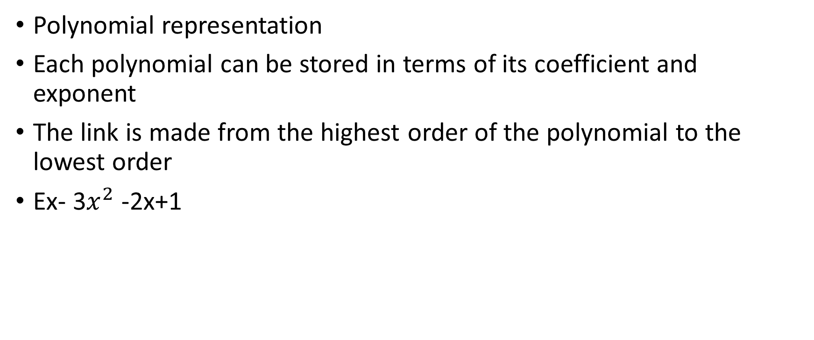
Application of Linked List
Polynomial representation
Each polynomial can be stored in terms of its coefficient and exponent
The link is made from the highest order of the polynomial to the lowest order
Ex- 3$x^{2}$ -2x+1
Exponent
Coefficient
3 2 10
-2 1 20
1 0 NULL

Slide 41
Code for creating such a struct
struct polynomial{
int exp;
float coeff;
struct polynomial *next;
}

Slide 42
Stack
It is a linear data structure that contains data of the same type and performs operations in a particular order –LIFO(Last In First Out)
Example-
A stack of Books
Operations on stack
Push-Inserting an element at the end of the stack
Pop- removing an element from the beginning of the stack
Peek/Top-Returns the top most element in the stack
Limiting Conditions
Overflow-When stack is full and u cannot push anymore elements
Underflow-When stack is empty and u cannot pop anymore elements

Slide 43
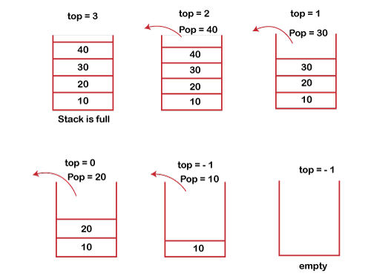
Stack Representation

Slide 44
Stack using Array-Push and Pop
Void push(int stack[], int value)
{
if(top == stack.length -1){
printf(“Overflow”);
}
else{
top++;
stack[top] = value;
}
}
int pop(int stack[])
{
int val;
if(top == -1)
{
printf(“Underflow”);
return -1;
} else {
val = stack[top];
top--;
return val;
}
}

Slide 45
Stack Using Array-Peek and Display
int peek(int stack[]){
if(top == -1){
printf(“Empty”);
return -1;
}
else{
return stack[top];
}
}
void display(int stack[]){
if(top == -1) {
printf(“Empty”);
}
else{
for(int i=top;i>=0;i--){
printf(“%d”, stack[i]);
}
}
}

Slide 46
Stack Using LinkedList-Push(same as inserting at the beginning)
struct node *push(struck node *top, int val){
struct node *newnode;
newnode = (struct node *) malloc(sizeof(struct node));
newnode->data=val;
If(top == NULL){
newnode->next = NULL;
top = newnode;
}
else{
newnode->next = top;
top = newnode;
}
return top;
}

Slide 47
POP-Deletion at the beginning
struct node *pop(struck node *top){
struct node *ptr;
ptr =top;
If(top == NULL){
printf(“Underflow”);
}
else{
top = top->next;
printf(“%d”, ptr->data);
free(ptr);
}
return top;
}

Slide 48
Peek and Display
int peek(struck node *top){
If(top == NULL){
printf(“Underflow”);
return -1;
}
else{
return top->data;
}
}
struct node *display(struck node *top){
struct node *ptr;
ptr =top;
If(top == NULL){
printf(“Empty”);
} else{
while(ptr->next!=NULL){
printf(“%d”, ptr->data);
ptr=ptr->next;
}
}
return top;}

Slide 49
Application of Stacks
Infix to Postfix Transition
Evaluation of Postfix expression

Slide 50
Infix, Prefix and Postfix
Infix expression
Where operators appear in between operands
Ex- A+B
PostFix Expression
Where operators appear after the operands
Ex- AB+
PreFix Expression
Where operators appear before the operands
Ex- +AB

Slide 51
Infix to Postfix using Stack-Algorithm
Scan the symbols of the expression from left to right and for each symbol do the following
If symbol is an operand
Print the symbol onto the screen
If Symbol is a left parenthesis
Push it onto the stack
If symbol is a right parenthesis
Pop all the operators from stack upto the first left parenthesis and print them on screen
Discard the left and right parenthesis
If symbol is an operator
if the precedence of the operators in the stack are greater than or equal to the current operator, then
Pop the operators out of the stack and print them onto the screen , and push the current operator onto the stack
else
Push the current operator onto the stack

Slide 52
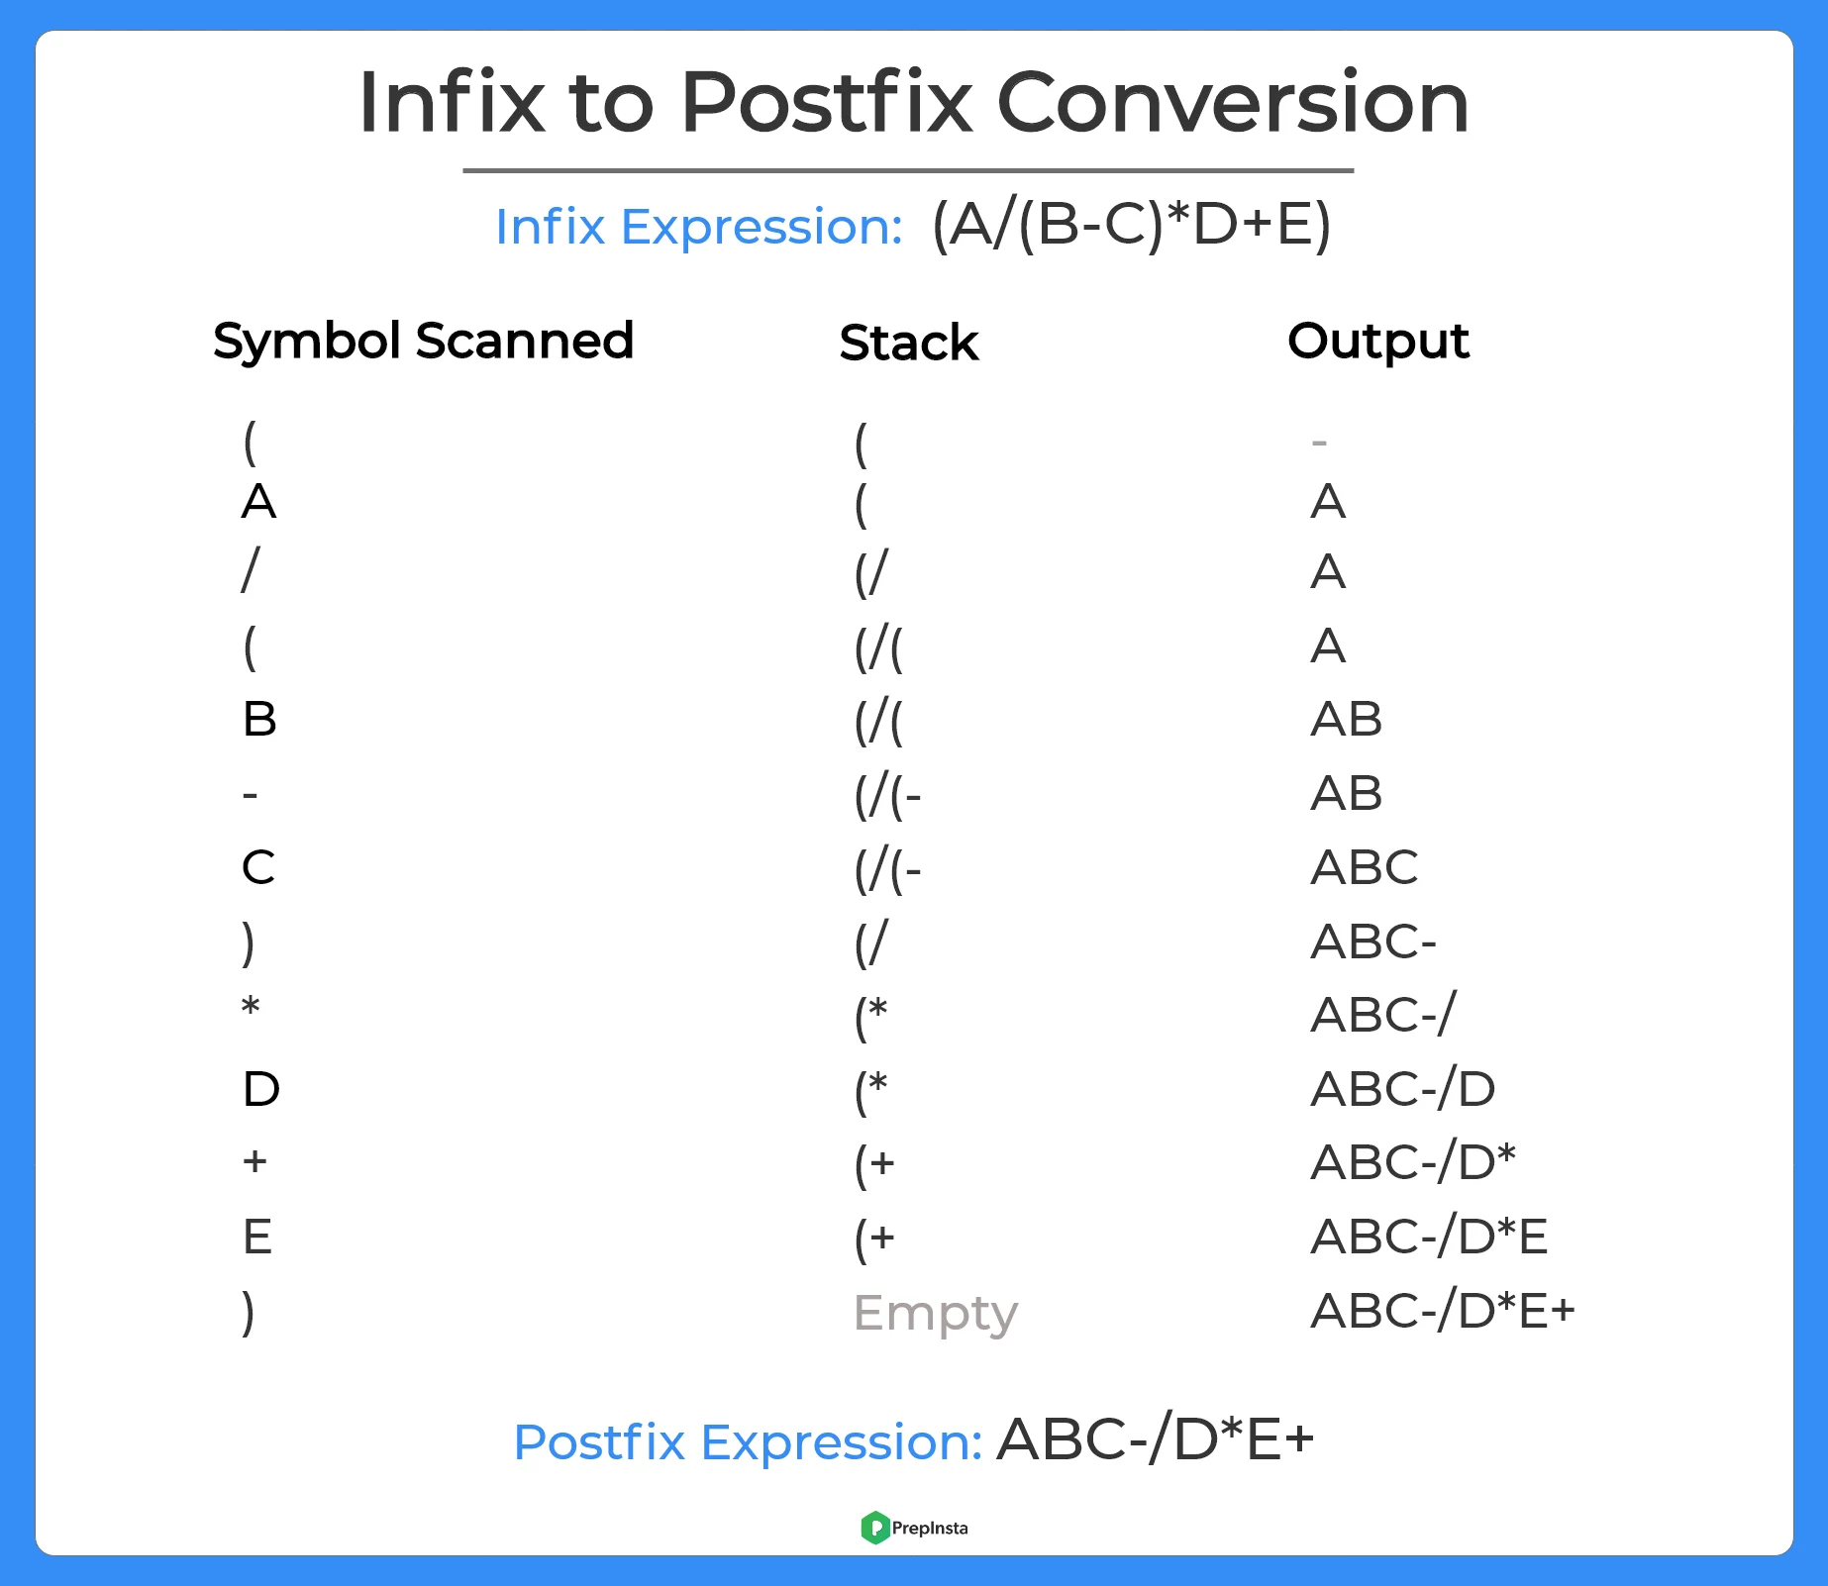
Example

Slide 53
Evaluation of Postfix expression
Scan the symbols of the given postfix expression from left to right and for each symbol do the following-
If symbol is an operand
Push it on the stack
If symbol is an operator
Pop the two symbols out of the stack and apply the operator on these symbols(Ex- if A is at the top of the stack and B is after it , we encounter an operator *, then do B*A)
Push the result on the stack
After scanning all the symbols of the postfix expression, pop the remaining symbol out of the stack and print it on the screen. The remaining symbol is the result obtained after evaluating the postfix expression

Slide 54
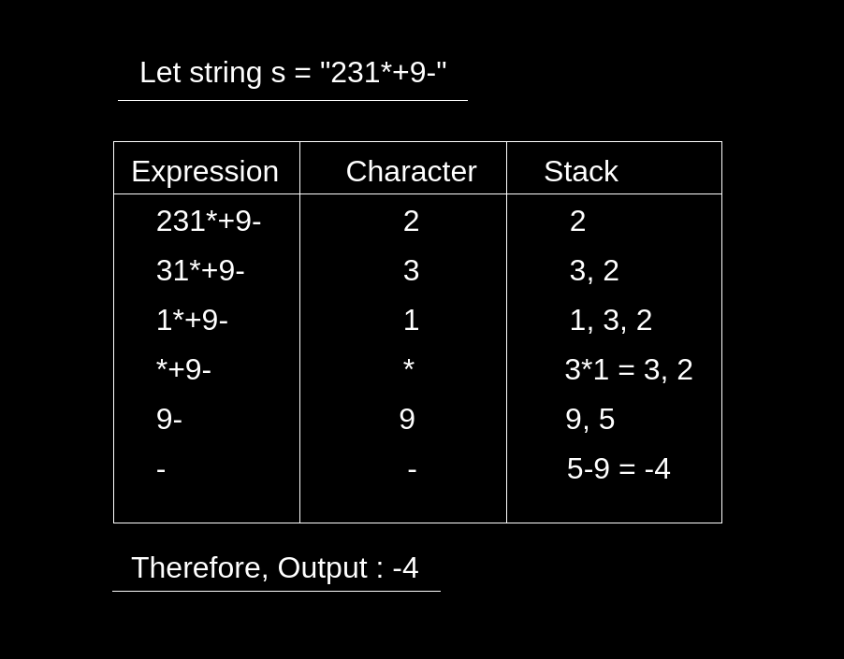
Example

